Slide 1
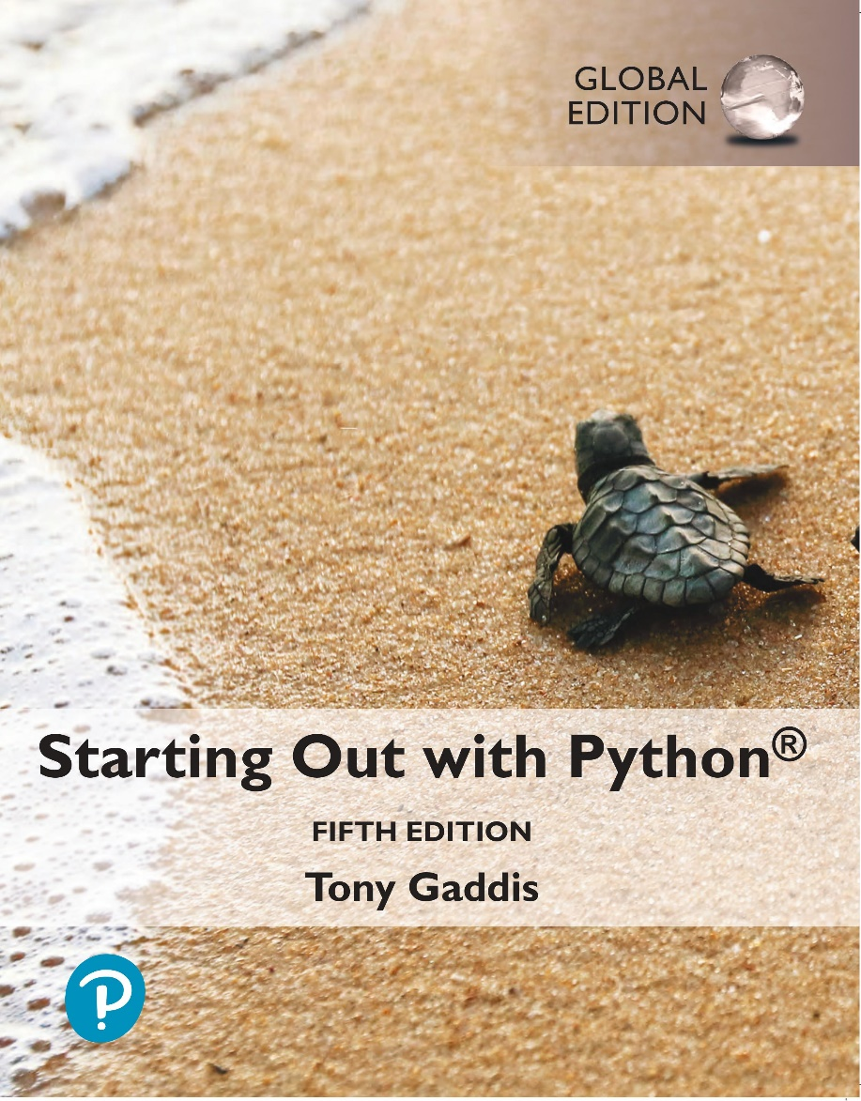
Starting out with Python
Fifth Edition, Global Edition
Chapter 5
Functions
Copyright © 2022 Pearson Education, Ltd. All Rights Reserved.

Slide 2
Topics
Introduction to Functions
Defining and Calling a Void Function
Designing a Program to Use Functions
Introduction to Value-Returning Functions: Generating Random Numbers
Writing Your Own Value-Returning Functions

Slide 3
Introduction to Functions (1 of 2)
Function: group of statements within a program that perform as specific task
Usually one task of a large program
Functions can be executed in order to perform overall program task
Known as divide and conquer approach
Modularized program: program wherein each task within the program is in its own function

Slide 4
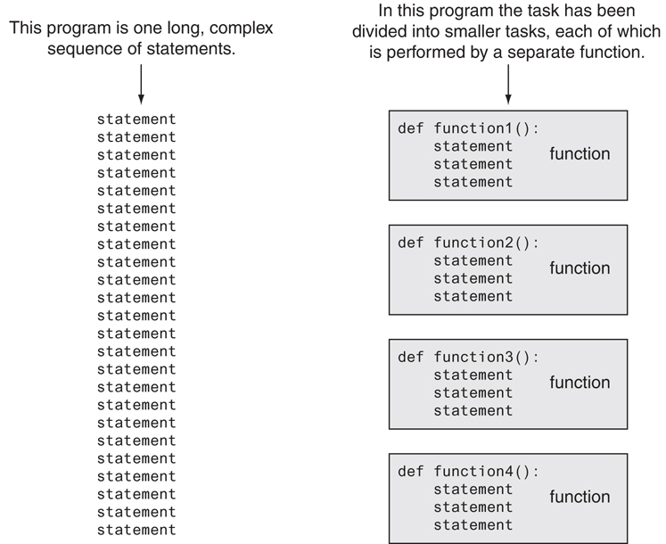
Introduction to Functions (2 of 2)
Figure 5-1 Using functions to divide and conquer a large task

Slide 5
Benefits of Modularizing a Program with Functions
The benefits of using functions include:
Simpler code
Code reuse
write the code once and call it multiple times
Better testing and debugging
Can test and debug each function individually
Faster development
Easier facilitation of teamwork
Different team members can write different functions

Slide 6
Void Functions and Value-Returning Functions
A void function:
Simply executes the statements it contains and then terminates.
A value-returning function:
Executes the statements it contains, and then it returns a value back to the statement that called it.
The input, int, and float functions are examples of value-returning functions.

Slide 7
Defining and Calling a Function (1 of 7)
Functions are given names
Function naming rules:
Cannot use keywords as a function name
Cannot contain spaces
First character must be a letter or underscore
All other characters must be a letter, number or underscore
Uppercase and lowercase characters are distinct

Slide 8
Defining and Calling a Function (2 of 7)
Function name should be descriptive of the task carried out by the function
Often includes a verb
Function definition: specifies what function does
def function_name():
statement
statement

Slide 9
Defining and Calling a Function (3 of 7)
Function header: first line of function
Includes keyword def and function name, followed by parentheses and colon
Block: set of statements that belong together as a group
Example: the statements included in a function

Slide 10
Defining and Calling a Function (4 of 7)
Call a function to execute it
When a function is called:
Interpreter jumps to the function and executes statements in the block
Interpreter jumps back to part of program that called the function
Known as function return

Slide 11
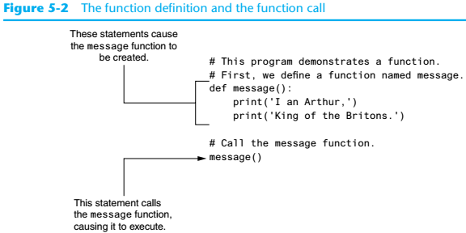
Defining and Calling a Function (5 of 7)

Slide 12
Defining and Calling a Function (6 of 7)
main function: called when the program starts
Calls other functions when they are needed
Defines the mainline logic of the program

Slide 13
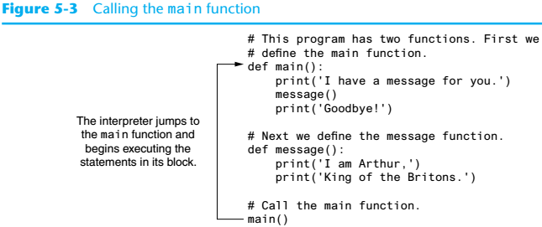
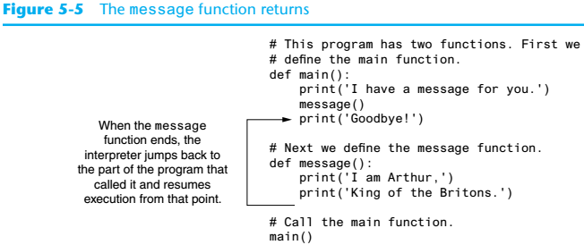
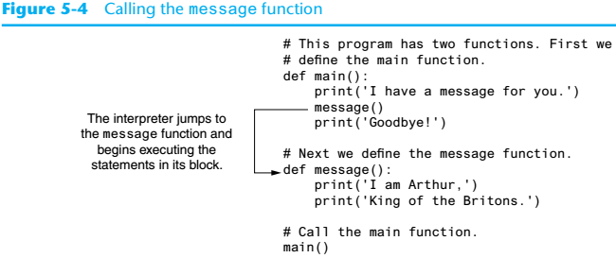
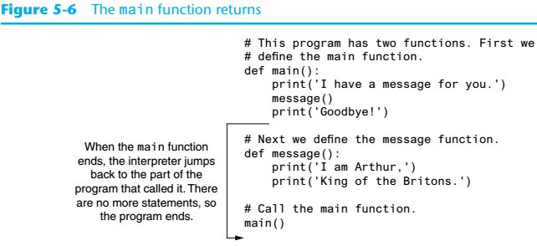
Defining and Calling a Function (7 of 7)

Slide 14
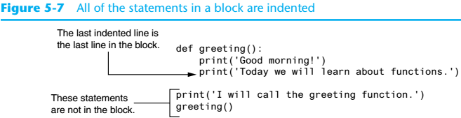
Indentation in Python
Each block must be indented
Lines in block must begin with the same number of spaces
Use tabs or spaces to indent lines in a block, but not both as this can confuse the Python interpreter
IDLE automatically indents the lines in a block
Blank lines that appear in a block are ignored

Slide 15
Örnek
Soru: Satır sayısı (yüksekliği) verilen bir ikizkenar üçgen çizdiren algoritma:

Slide 16
Designing a Program to Use Functions (1 of 2)
In a flowchart, function call shown as rectangle with vertical bars at each side
Function name written in the symbol
Typically draw separate flow chart for each function in the program
End terminal symbol usually reads Return
Top-down design: technique for breaking algorithm into functions
Use input function to have program wait for user to press enter

Slide 17
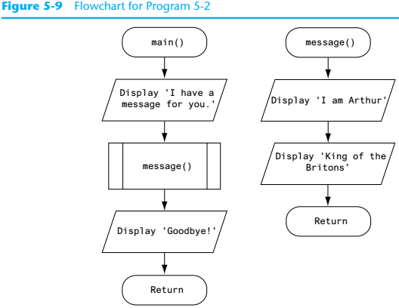
Designing a Program to Use Functions (2 of 2)

Slide 18
Introduction to Value-Returning Functions: Generating Random Numbers
void function: group of statements within a program for performing a specific task
Call function when you need to perform the task
Value-returning function: similar to void function, returns a value
Value returned to part of program that called the function when function finishes executing

Slide 19
Standard Library Functions and the import Statement (1 of 3)
Standard library: library of pre-written functions that comes with Python
Library functions perform tasks that programmers commonly need
Example: print, input, range
Viewed by programmers as a “black box”
Some library functions built into Python interpreter
To use, just call the function

Slide 20
Standard Library Functions and the import Statement (2 of 3)
Modules: files that stores functions of the standard library
Help organize library functions not built into the interpreter
Copied to computer when you install Python
To call a function stored in a module, need to write an import statement
Written at the top of the program
Format: import module_name

Slide 21

Standard Library Functions and the import Statement (3 of 3)
Figure 5-19 A library function viewed as a black box

Slide 22
Writing Your Own Value-Returning Functions (1 of 3)
To write a value-returning function, you write a simple function and add one or more return statements
Format: return expression
The value for expression will be returned to the part of the program that called the function
The expression in the return statement can be a complex expression, such as a sum of two variables or the result of another value-returning function

Slide 23
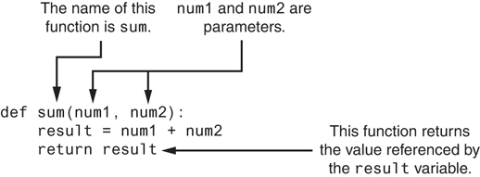
Writing Your Own Value-Returning Functions (2 of 3)
Figure 5-23 Parts of the function

Slide 24
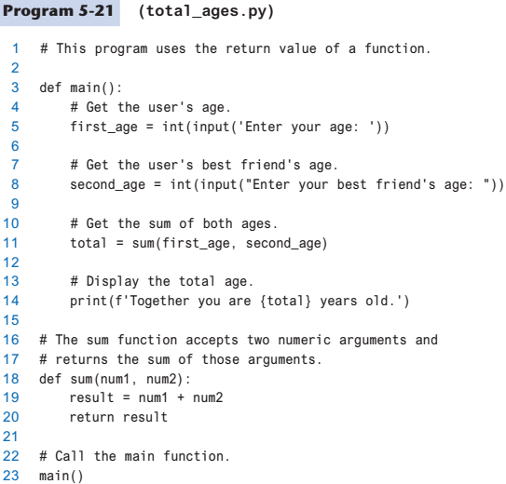

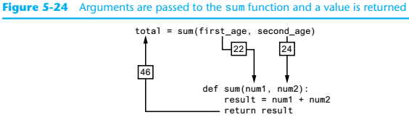
Writing Your Own Value-Returning Functions (3 of 3)

Slide 25
How to Use Value-Returning Functions (1 of 2)
Value-returning function can be useful in specific situations
Example: have function prompt user for input and return the user’s input
Simplify mathematical expressions
Complex calculations that need to be repeated throughout the program
Use the returned value
Assign it to a variable or use as an argument in another function

Slide 26
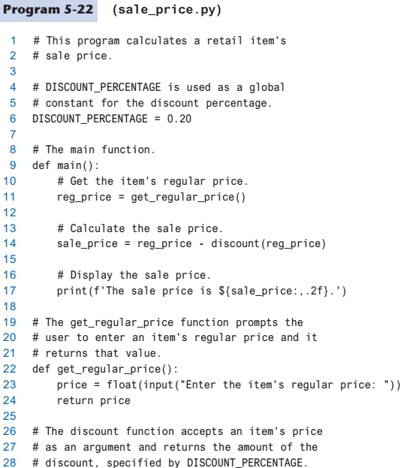

How to Use Value-Returning Functions (2 of 2)

Slide 27
Örnek
Soru: Parametre olarak aldığı 3 farklı sayının en büyüğünü döndüren fonksiyon:

Slide 28
Örnek
Soru: Girilecek 100 adet (x,y) değerleri için denklemi aşağıda görülen f(x,y) fonksiyonunun max ve min değerlerini bulan algoritma:

Slide 29

Örnek
Soru: Aşağıda görülen f(x) serisinin terim sayısını ve x değerini kullanıcıdan alan ve serinin değerini bulan algoritma:

Slide 30
Returning Strings
You can write functions that return strings
For example:
def get_name():
# Get the user’s name.
name = input(‘Enter your name:’)
# Return the name.
return name

Slide 31
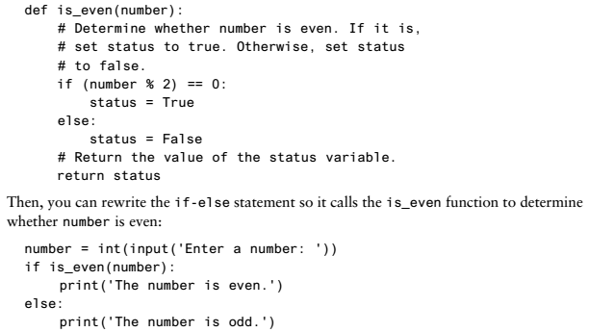
Returning Boolean Values (1 of 2)
Boolean function: returns either True or False
Use to test a condition such as for decision and repetition structures
Common calculations, such as whether a number is even, can be easily repeated by calling a function

Slide 32

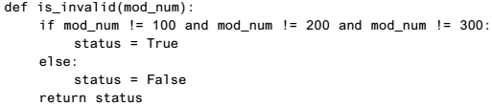
Returning Boolean Values (2 of 2)
Boolean function: returns either True or False
Use to simplify complex input validation code

Slide 33
Örnek
Soru: Verilen bir karakterin harf olup olmadığını (Türkçe harfler dahil) döndüren fonksiyon:

Slide 34
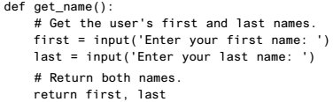
Returning Multiple Values
In Python, a function can return multiple values
Specified after the return statement separated by commas
Format: return expression1,
expression2, etc.
When you call such a function in an assignment statement, you need a separate variable on the left side of the = operator to receive each returned value

Slide 35
Örnek
Soru: Bir bölme işleminde hem bölümü hem kalanı döndüren fonksiyon:

Slide 36
Returning None From a Function (1 of 2)
The special value None means “no value”
Sometimes it is useful to return None from a function to indicate that an error has occurred
def divide(num1, num2):
if num2 == 0:
result = None
else:
result = num1 / num2
return result

Slide 37
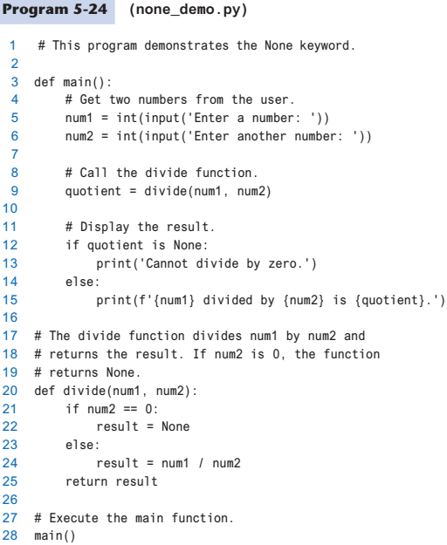
Returning None From a Function (2 of 2)

Slide 38
Menu Driven Programs
Menu-driven program: displays a list of operations on the screen, allowing user to select the desired operation
List of operations displayed on the screen is called a menu
Program uses a decision structure to determine the selected menu option and required operation
Typically repeats until the user quits

Slide 39
Summary
This chapter covered:
The advantages of using functions
The syntax for defining and calling a function
Methods for designing a program to use functions
Value-returning functions, including:
Writing value-returning functions
Using value-returning functions
Functions returning multiple values
Using library functions and the import statement

